Slide 1
Endofotonics
Data Analysis
SingMass 27 February 2023

Slide 2
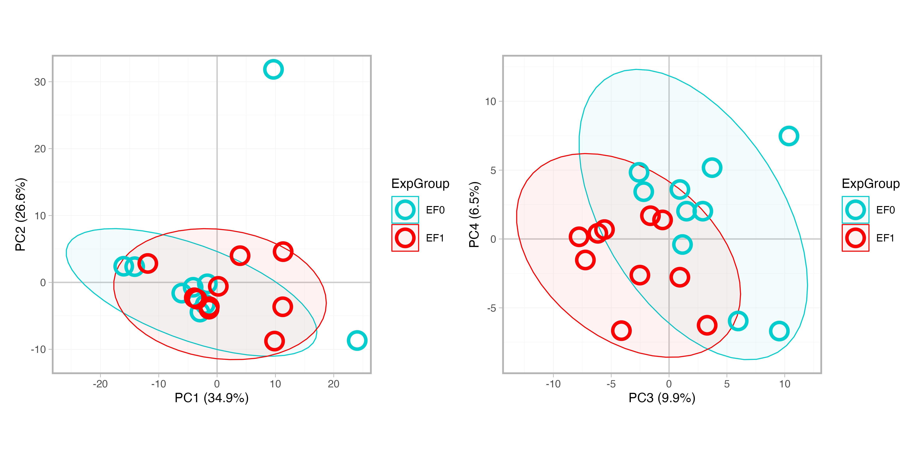
PCA
EF0-73
EF0-92

Slide 3
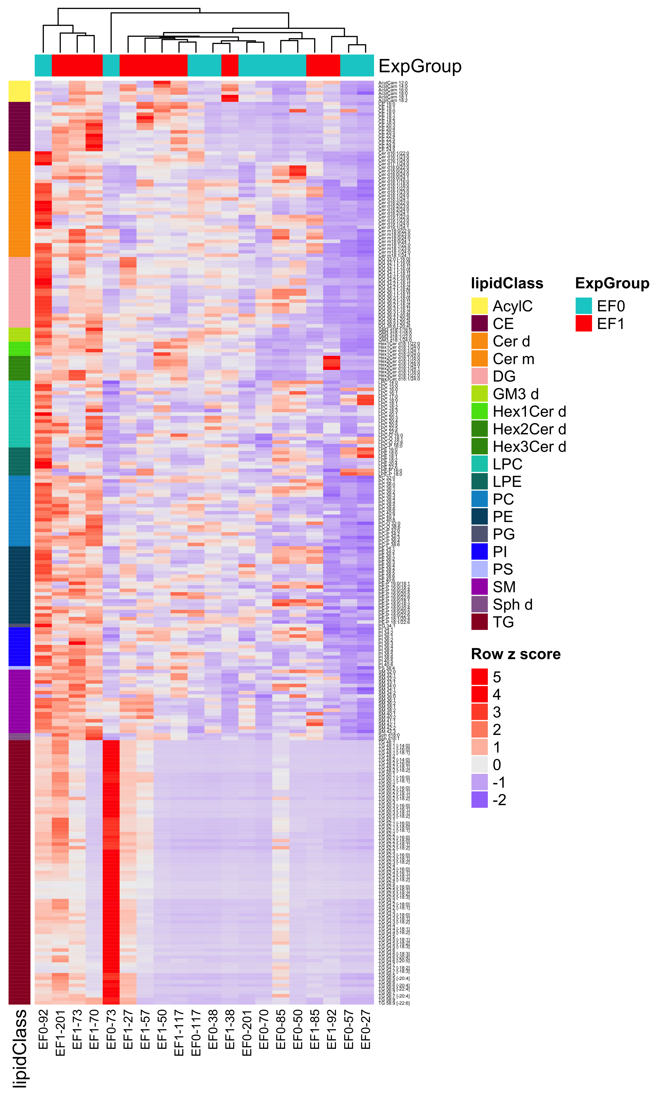
Clustering
Note: samples treated as independent

Slide 4
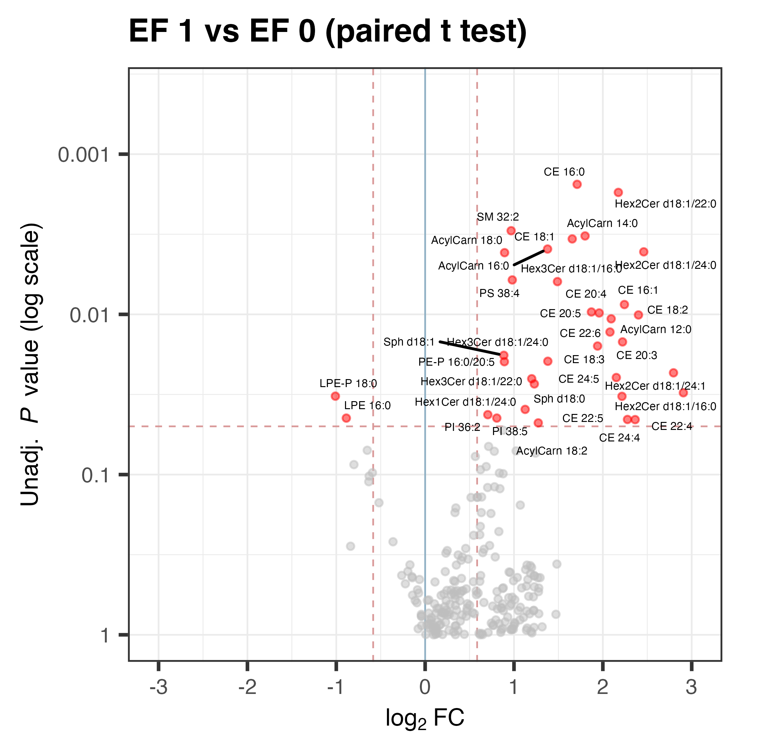
Comparison

Slide 5
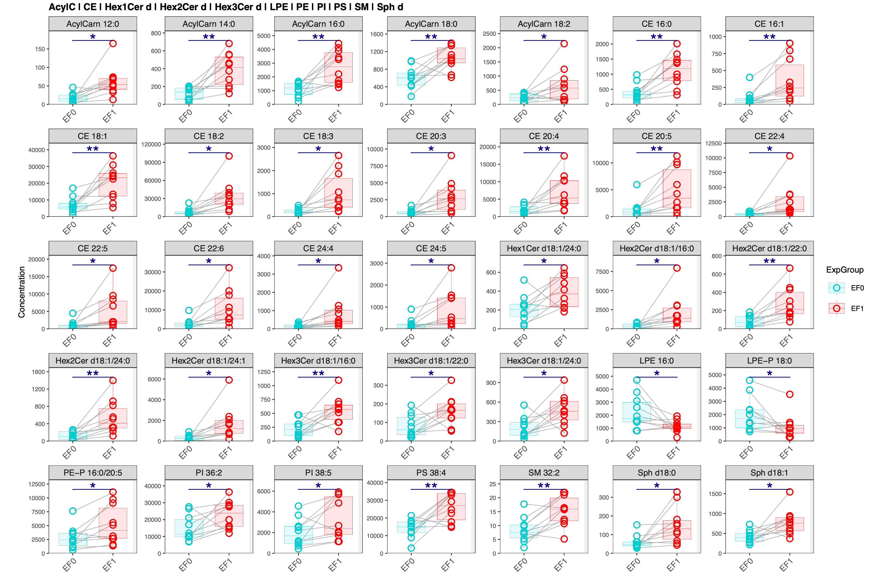
Species with significant differences between groups

